Slide 1
MASS SHOOTING
GROUP 5
Zahra abbas
Benedict ferro
Prachi dedhia
Nilava Mukherjee
Michael rossi
Pan chen

Slide 2
Introduction
Mass shooting has always been a widely discussed topic. More than any other forms of crime, the intensity of this form of crime is worrisome.
Mass shootings have a devastating impact on our communities from the victims killed, to the surviving witnesses, to the public at large. In order to prevent such tragic violence in the future, we must understand how and why these incidents unfold.
We are trying to find the general trend and reasons or factors that might be responsible behind these horrible incidents

Slide 3
MASS SHOOTING
PART A: Descriptive Analysis of the Data
Describing the source of data
Population of Interest
Variables Captured
PART B: Analyzing the association between the variables
Initial Expectations
Identifying the dependent and Independent variables
Scatter Plots and Correlation Analysis
Multiple Regression Analysis

Slide 4
PART A: Descriptive Analysis of the Data
Data Source and Collection method: Secondary method of data was used for this project. The data set was obtained from Kaggle.
(https://www.kaggle.com/zusmani/us-mass-shootings-last-50-years)
Data Valid as of: November 1, 2017
Data Set Size: 323 major shootings that took place in United States in the last 50 years.
Population of Interest: General Citizens, Shooters, Police force, Gun control law makers
Data Type: This is a cross sectional time series data. This is a not a random sample since it includes the information on all the shooting incidents that have taken place since the last 50 years in United States

Slide 5
Definition of the Variables
Variable | Variable Type | Description
Title | Categorical - Nominal | Name and the place where the shooting incidents have taken place
City | Categorical – Nominal | Cities where the shootings have take place
State | Categorical – Nominal | States where the shootings have taken place
Date | Quantitative – Discrete | Date on which the shootings occurred
Incident Area | Categorical – Nominal | The area/ place where mass shooting took place
Open/Close Location | Categorical – Ordinal | Whether the location was an open public area or a closed location
Target | Categorical – Ordinal | The category of the people affected in the mass shooting
Cause | Categorical – Ordinal | The reason behind why the shooter conducted the shooting
Fatalities | Quantitative – Discrete | Number of deaths caused due to mass shooting incident
Injured | Quantitative – Discrete | Number of people being injured because of the mass shooting
Total Victims | Quantitative – Discrete | Total number of victims affected in the mass shooting (Fatalities + Injured)
Policemen Killed | Quantitative – Discrete | The number of policemen killed in the mass shooting incident
Age | Quantitative – Discrete | The age of the shooter
Employed | Categorical – Ordinal | Whether the shooter was employed or not
Employed at | Categorical – Nominal | If the shooter was employed, where was he/she employed
Mental Health Issue | Categorical – Ordinal | Whether the shooter has ay mental illness or not
Race | Categorical – Ordinal | The race of the shooter
Gender | Categorical – Ordinal | The gender of the shooter
Latitude | Quantitative - Continuous | The geographic angle at which the shooting took place
Longitude | Quantitative - Continuous | The geographic angle at which the shooting took place

Slide 6


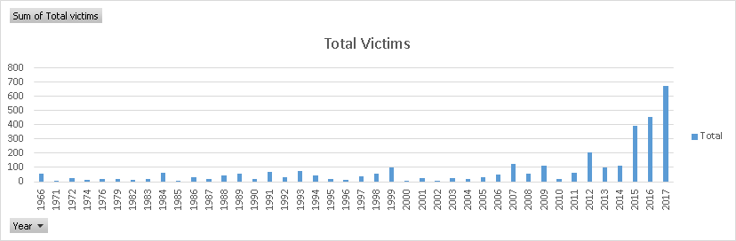



Increasing Trend of the Total Number of Victims from 1966 to 2017

Slide 7
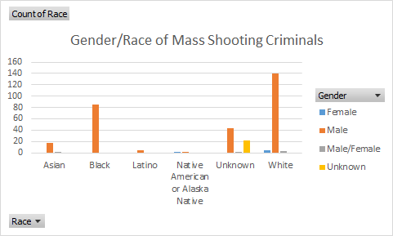
Breaking Down Mass Shooting Criminals by Gender and Race
(White Males being the highest amongst the other shooters)

Slide 8
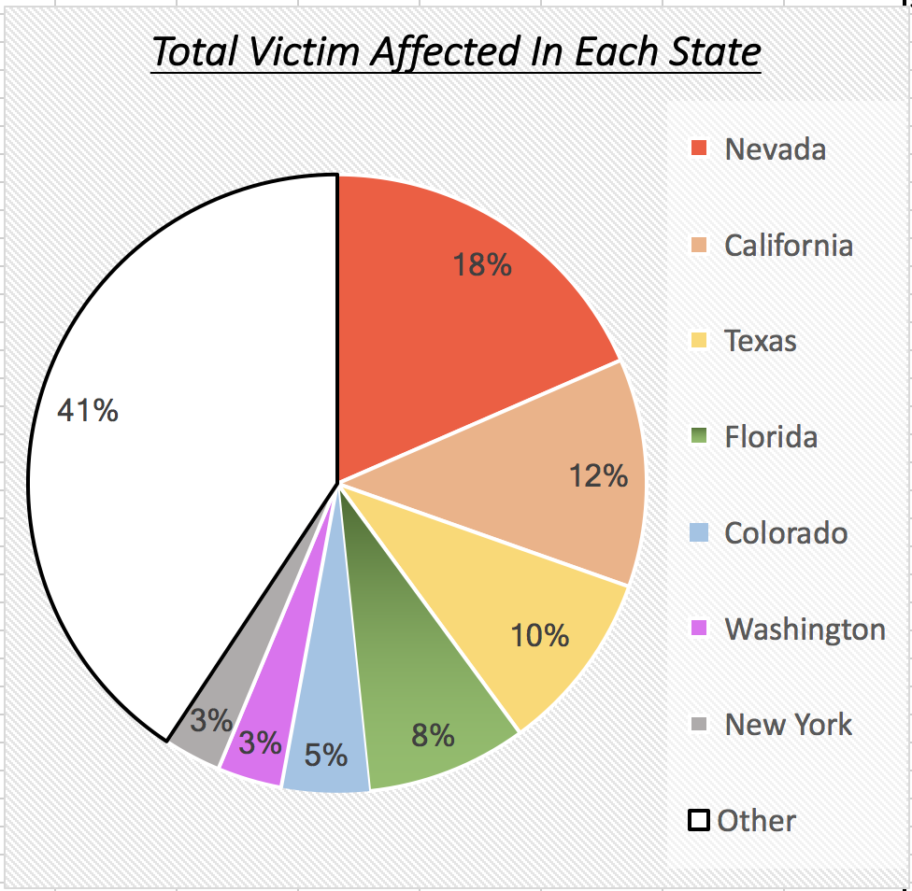
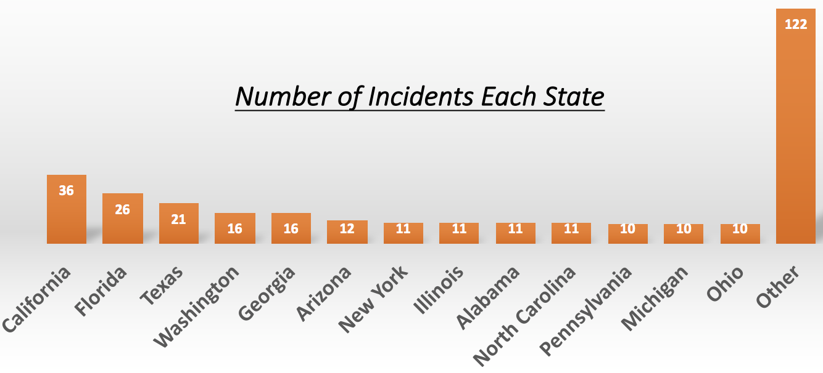
Total Number of Victims Affected – State (Nevada observed the highest number of victims affected)
Total Number of Incidents – State
(California had the highest number of mass shooting incidents)

Slide 9
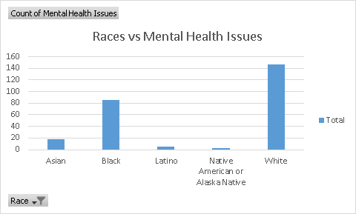
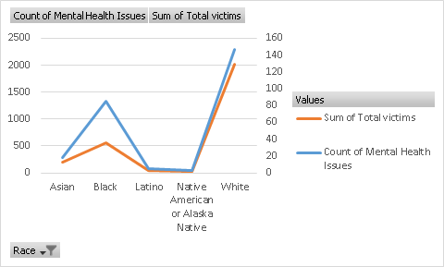
Mental Health Issues Observed Amongst Race (Most Mental Health Issues are from White followed by Black)

Slide 10
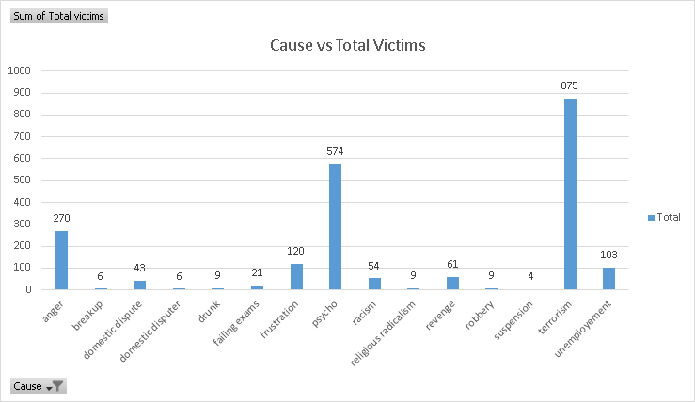
Terrorism, Psychotic Behavior and Anger are the Three Main Causes
of Mass Shooting

Slide 11
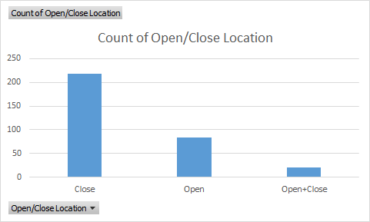
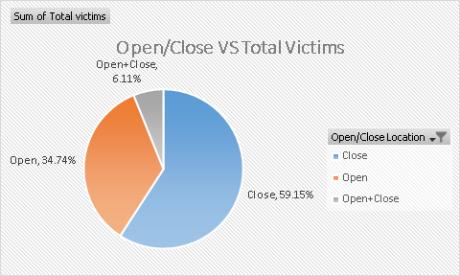
Total Number of Victims Affected by Locations
(Closed Locations were Main Targets for Mass Shootings)
Total Number of Open/Close/Open+Close Locations

Slide 12
PART B: Analyzing the association between the variables
Initial Expectations:
Age: We want to see if younger shooters tend to cause more injuries and/or fatalities.
Gender: We want to see if male shooters tend to kill/hurt more people than female shooters.
Race: We don’t have any expectations for this one. We just want to see if a shooter’s race makes difference in the number of victim he/she caused
Mental illness or not: We want to see if a shooter with mental illness would harm more people than the shooters without mental illness
Open space or not: We want to see if a shooter shot in close space would kill/hurt more people than in open space.

Slide 13
Dependent and Independent Variables
Type of Variable | Variables
Dependent Variable | Total Number of Victims
Independent Variable | Shooter’s Age Gender Race Mental Illness (Yes or No) Locations (Open, Close, Open + Close)
Dummy Variables | Locations (Open , Close) Race Gender Mental Health Illness
Interaction Variable | Race*Age

Slide 14
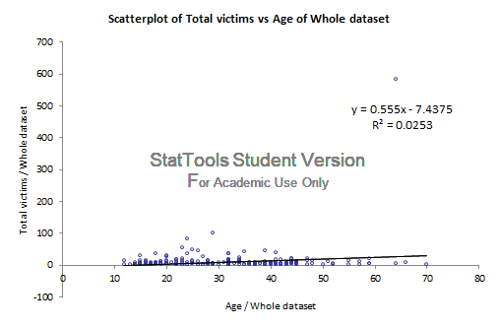


Total Number of Victims vs Age of the shooters

Slide 15
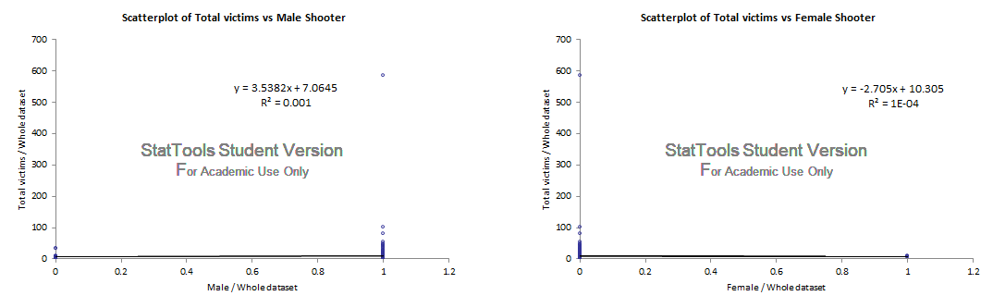
Correlation between Total number of Victims and Gender of the Shooter

Slide 16
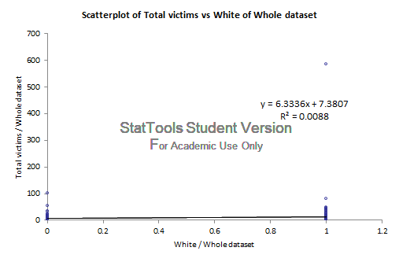
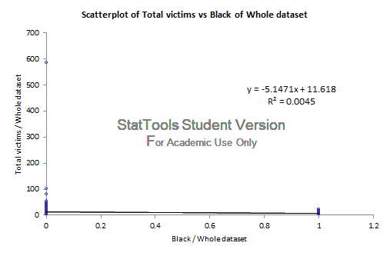
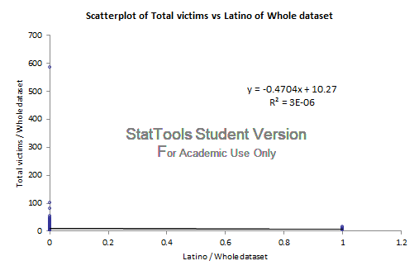
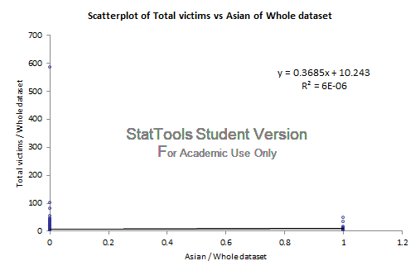
Correlation between Total number of Victims and Race of the Shooter

Slide 17
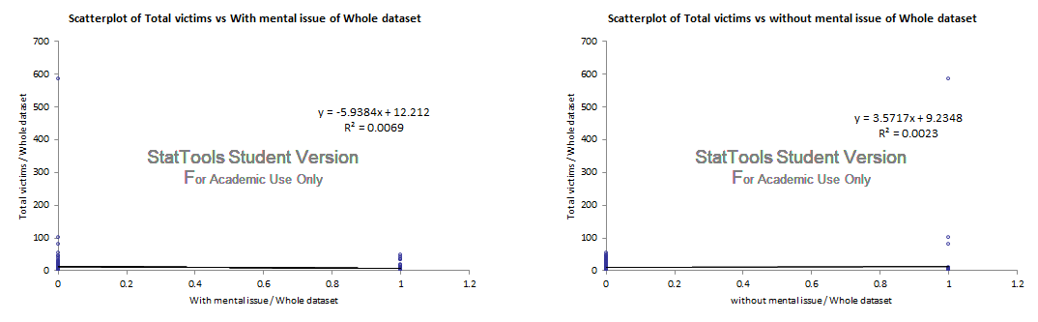
Correlation between the total number of victims and the mental health of the shooter

Slide 18
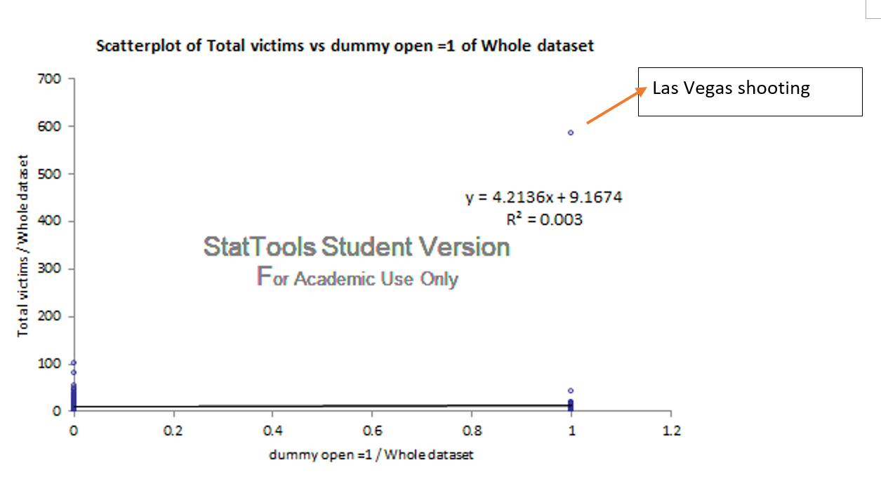
Correlation between Total number of victims and Location (Open/Close)

Slide 19
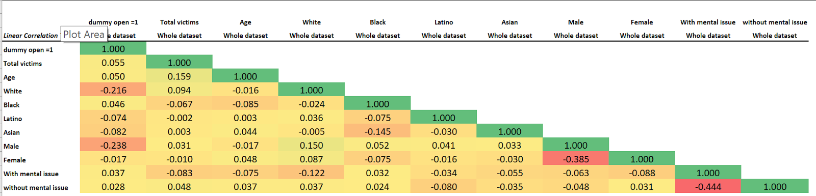
Correlation Analysis
1. Age and Total number of victims have the highest correlation. However, the correlation not being very high indicates that there may be other important factors that would strongly represent the relationship with Total number of victims.

Slide 20
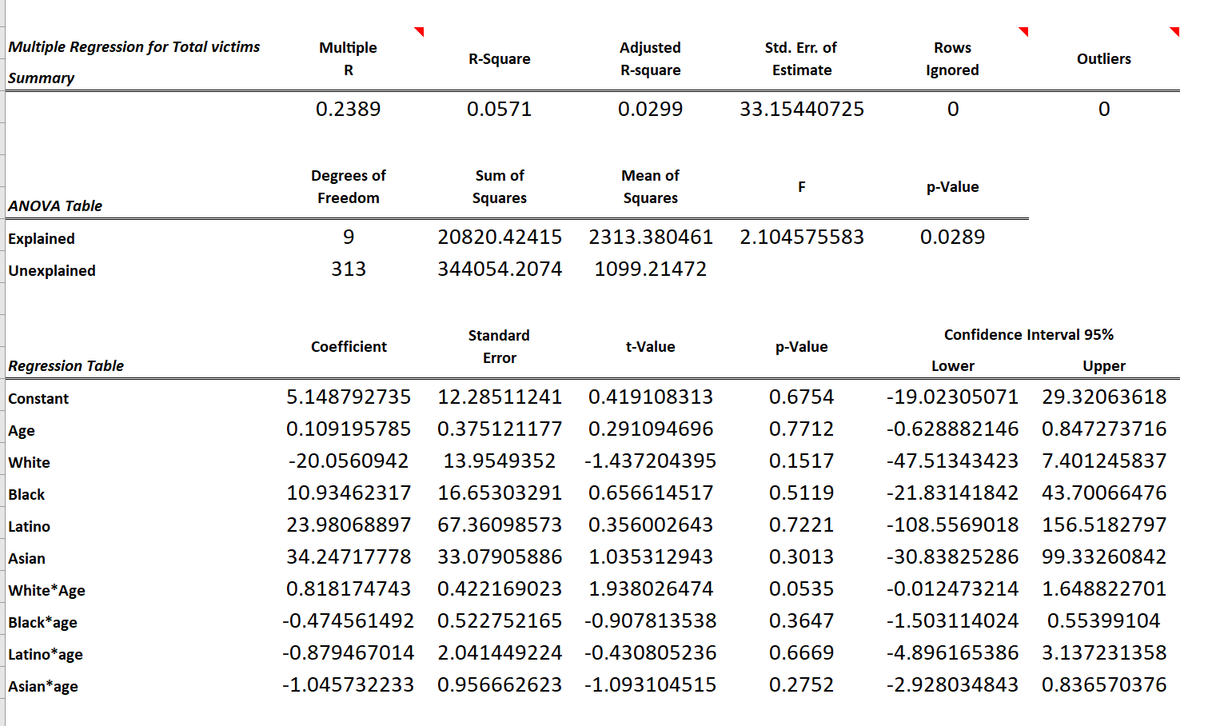
Multiple Regression Analysis
Yhat = 5.15 + 0.11*age - 20.01*White + 10.93*Black + 23.98*Latino + 34.25*Asian + 0.82*White*Age
- 0.46*Black*age - 0.88*Latino*age - 1.05*Asian*Age

Slide 21
Conclusions
There are other factors which might be more important than the ones we have analyzed from the present data set.
The bigger problem here is not related to a particular race, age or mental issues, but factor like gun control laws might be more substantial.

